Slide 1
Chapter 5 Review and Practice
Lecture 25

Slide 2
Final Exam Extra credit for creative course summary:
If you summarize the course material on one page in a creative way (e.g., using drawing, tables, figures, and so on), you will get 4 to 7 extra points, depending on the quality of your summary.
These extra points will be added to your final exam. It is better that you summarize the whole course, but if you can not, you should summarize at least two of the last three chapters (e.g., chapter 3 & 4 or chapter 4 & 5).
If you want to gain the extra credit, please hand in your course summary on the final exam day. Please remember to write your name on the summary. (Of course, it needs to be neat and easy to read.)

Slide 3
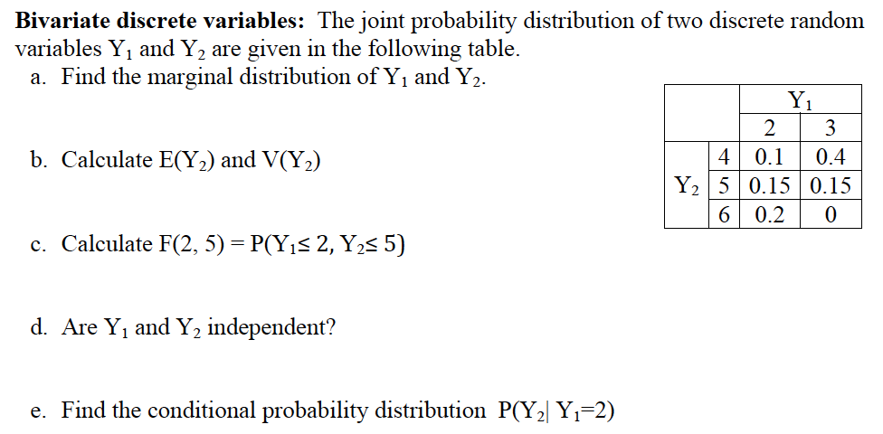
Chapter 5 Review and Practice Questions

Slide 4
